Slide 1
New material for Lecture 1A&B

Slide 2
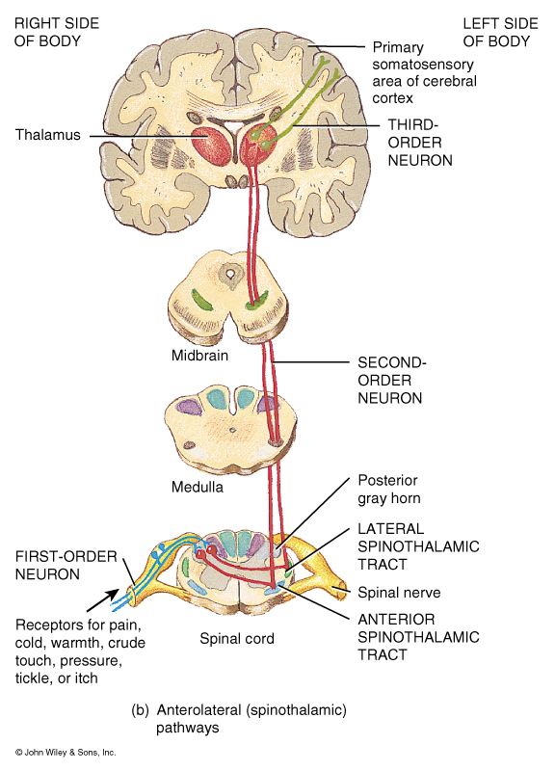
Organization of
Sensory or Ascending
Pathways

Slide 3
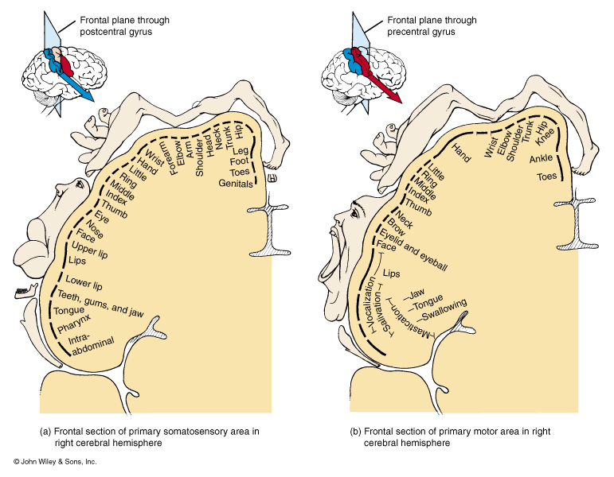

Slide 4
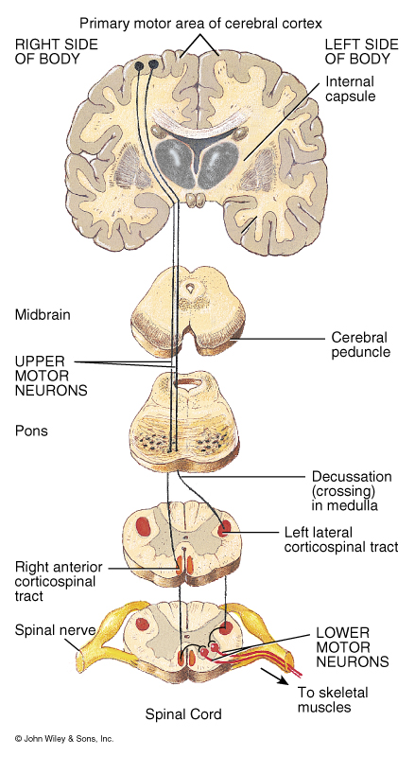

Slide 6
Function and Structure of the Reticular Formation
The Reticular Activating System is the attention center in the brain. It is the key to "turning on your brain," and also seems to be the center of motivation. Ie, helps mediate transitions from sleep and relaxed wakefulness to periods of high attention.
In order that the brain may sleep, there must be a reduction in ascending afferent activity reaching the cortex by suppression of the RAS
the Reticular Activating System is a very complex collection of neurons that serve as a point of convergence for signals from the external world and from interior environment.
It plays a significant role in determining whether a person can learn and remember things well or not, on whether or not a person is impulsive or self-controlled, on whether or not a person has high or low motor activity levels, and on whether or not a person is highly motivated or bored easily.

Slide 7
Function and Structure of the Reticular Formation
Developmental Influences:
Preterm birth: Regardless of birth weight or weeks of gestation, premature birth induces persistent deleterious effects on pre-attentional (arousal and sleep-wake abnormalities), attentional (reaction time and sensory gating), and cortical mechanisms throughout development
Smoking during pregnancy: exposure to cigarette smoke is known to produce lasting arousal, attentional and cognitive deficits in humans

Slide 8
Function and Structure of the Reticular Formation
Pathologies:
Given the importance of the RAS for modulating cortical changes, disorders of the RAS should result in alterations of sleep-wake cycles and disturbances in arousal. Has been implicated in:
Schizophrenia
Narcolepsy
Progressive supranuclear palsy (PSP)
Depression, autism, Alzheimer’s disease, attention deficit disorder

Slide 9
Function and Structure of the Reticular Formation
Pathologies:
Given the importance of the RAS for modulating cortical changes, disorders of the RAS should result in alterations of sleep-wake cycles and disturbances in arousal. Has been implicated in:
Schizophrenia
Narcolepsy
Progressive supranuclear palsy (PSP)
Depression, autism, Alzheimer’s disease, attention deficit disorder

Slide 10
New material for lecture 2

Slide 11
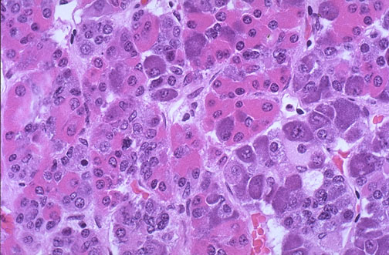
Hormones Released from the Anterior Pituitary or Adenohypophysis
Somatotrophs
Human Growth Hormone (hGH)
Hypothalamic control
hGH releasing hormone
hGH inhibiting hormone
Target Tissues:
General body cells, particularly bone, muscle, cartilage, and the liver.

Slide 12
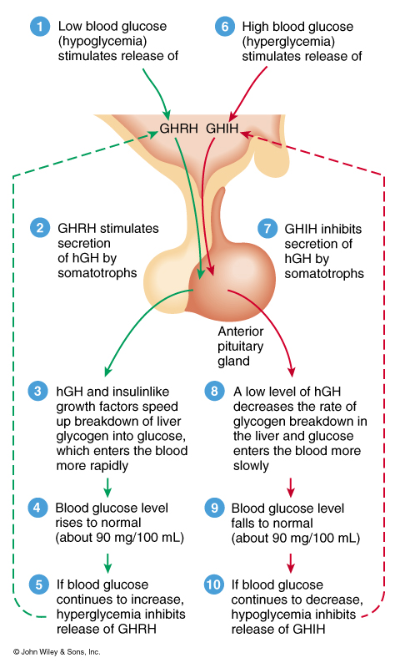
Hormones Released from the Anterior Pituitary or Adenohypophysis
Hormone affects:
promotes the synthesis of insulin-like growth factors
Controls normal growth patterns by increasing protein synthesis, lipolysis, ATP production, and carbohydrate metabolism
In adults, it help maintain muscle and bone mass and promote healing and tissue repair

Slide 13
Hormones Released from the Anterior Pituitary or Adenohypophysis
Hypo-secretion:
During childhood causes pituitary Dwarfism
Hyper-secretion:
During childhood causes
Gigantism
During Adulthood causes
Acromegaly: Enlargement of the small bones of the hand and feet
Enlargement of the cranium, nose, and lower jaw
Tongue, liver, and kidneys become enlarged

Slide 14
Pituitary Dwarfism
Dwarfism is a condition in which the growth of the individual is very slow or delayed. Decreased bodily growth is due to hyposecretion of hGH. The end result is a proportionate little person, because height as well as growth of other structures are also decreased.
Can be caused by gene mutations:
Appears to be disruption on different areas of chromosome 3 and 7. Some studies have isolated defects for the production of pituitary hormones to the short arm (the "p" end) of chromosome 3 at a specific location of 3p11. Other studies have found changes on the short arm of chromosome 7.
Or tumors:
Most commonly craniopharyngioma (a tumor near the pituitary gland), children and adolescents.
Symptoms: headaches, vomiting, problems with vision (double vision), excessive drinking behaviors (polydipsia) and sleep disturbances may be common.
,

Slide 15
Pituitary Gigantism
Hyper secretion of human growth hormone (hGH) before the end of adolescence. People with pituitary gigantism can truly be giants. They can sometimes end up over 7 or 8 feet in height.
Typically caused by an adenoma (tumor) of the pituitary.

